Slide 1
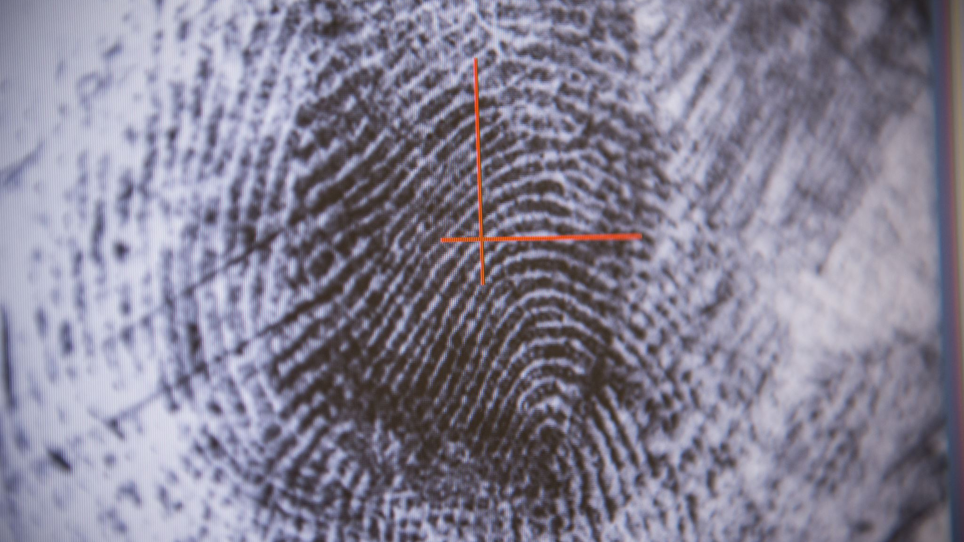
Fake News Detection Using Transformers
Brosgard Emil - 22299009

Slide 2
Agenda
Introduction
Model and Dataset
Explorotary Data Analysis and preprocessing
Results
Conclution

Slide 3
Introduction
Fake news detection has become a critical task in the digital age, where misinformation can spread rapidly across online platforms, influencing public opinion and decision-making.
By fine-tuning pre-trained transformers such as Bert or GPT, on labeled datasets, these models can learn to detect patterns indicative of fake news, such as exaggerated claims, clickbait phrases, or inconsistencies in the narrative.

Slide 4
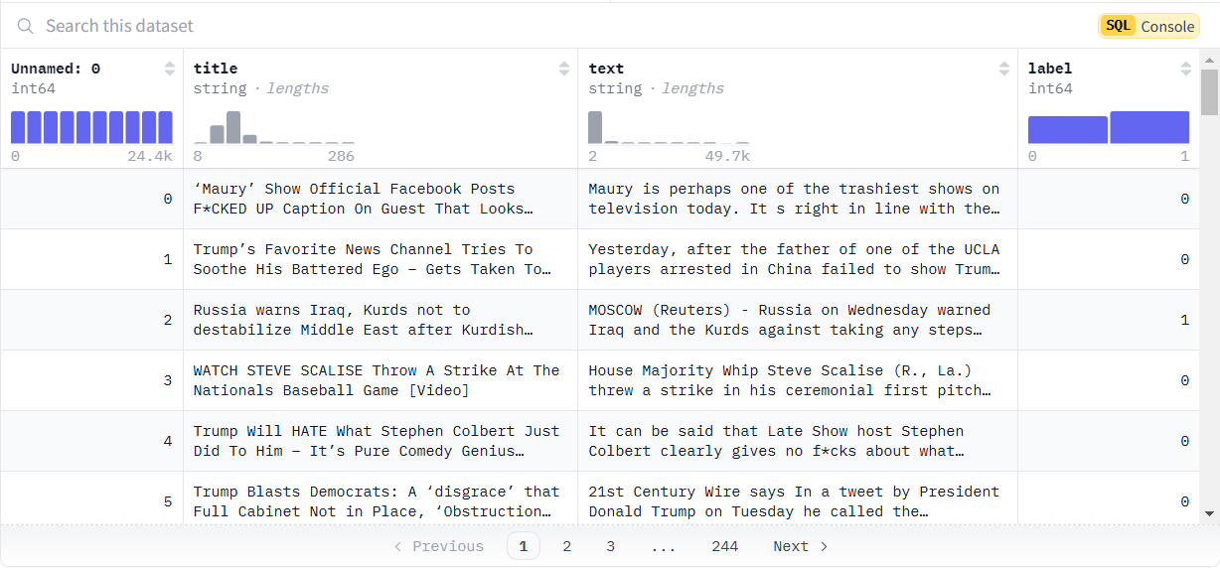
Dataset
- This dataset is a mix of multiple fake news data sets from Kaggle.
- Articles are classified as true (1) or false (0)

Slide 5
Model
Fake-News-Bert-Detect
Model is based on the RoBERTa-base architecture that has been fine-tuned for the task of fake news detection.
Trained on over 40 000 news articles from various sources.

Slide 6
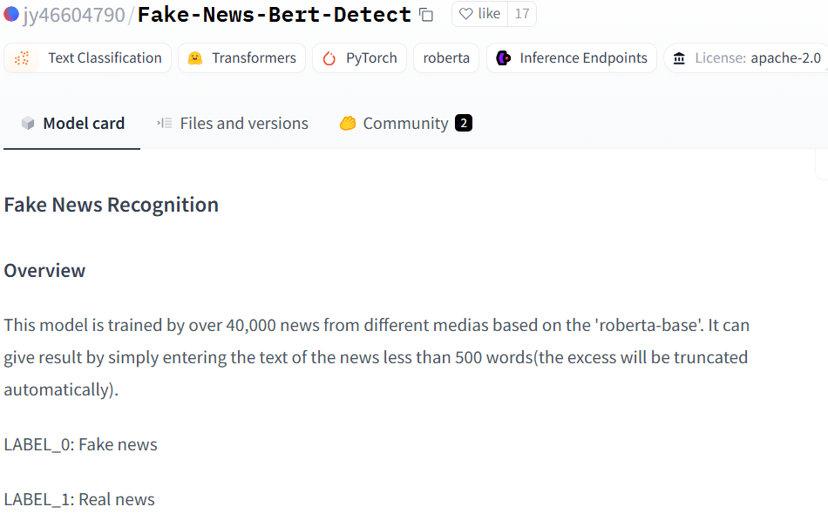
Fake-News-Bert-Detect
BERT is a transformer-based architecture pre-trained on large corpora like Wikipedia and BookCorpus using unsupervised learning.
Fake-News-BERT-Detect fine-tunes BERT on labeled datasets of fake and real news to achieve better domain-specific results.
Fine-tuning is performed on datasets such as LIAR, FakeNewsNet, or custom datasets to adapt the model to the fake news detection task.

Slide 7
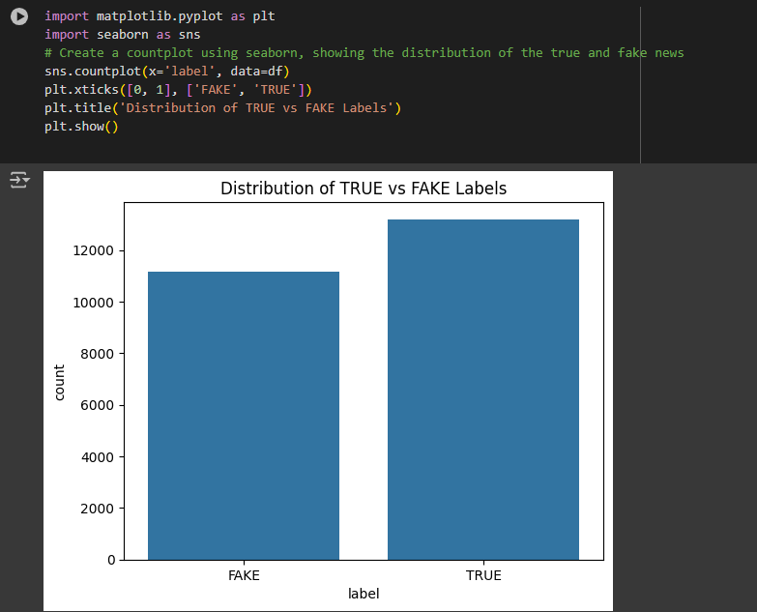
Explorotary Data Analysis

Slide 8
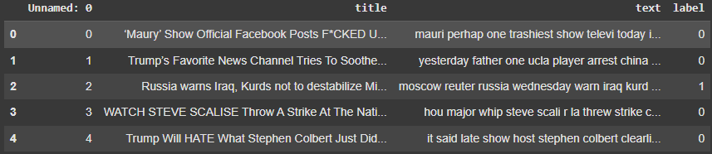
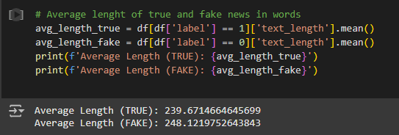

Slide 9
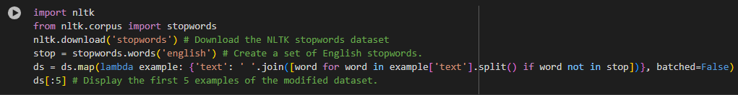

Preprocessing

Slide 10
It s right in line with the likes of the gutter trash that is Jerry Springer, and the fact that those shows are still on the air with the shit they air really is a sad testament to what Americans find to be entertaining.
It right line likes gutter trash Jerry Springer fact shows still air shit air really sad testament Americans find entertaining
it right line like gutter trash jerri springer fact show still air shit air realli sad testament american find entertain

Slide 11
Results
Title
Preprocessed text
Un-preprocessed text

Slide 12

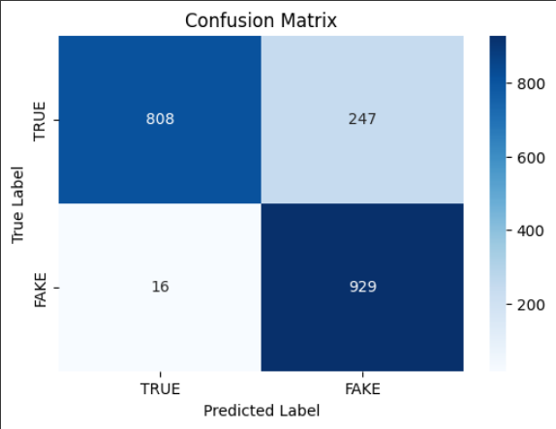
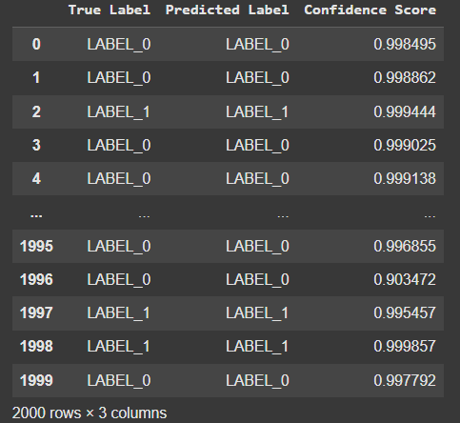
Results from the title of the article
Consider that the fine-tuning on the model is focused on the text and not title.

Slide 13
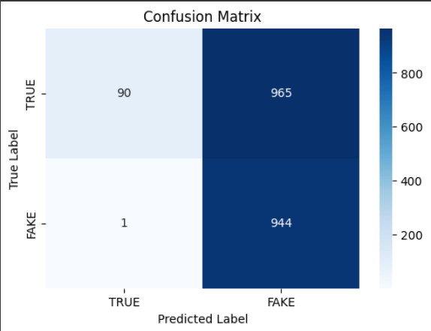
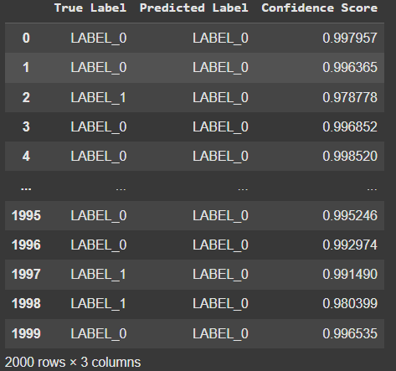
Results from the preprocessed text
Strong bias toward predicting news as fake. The model may rely heavily on certain features eliminated during preprocessing.

Slide 14

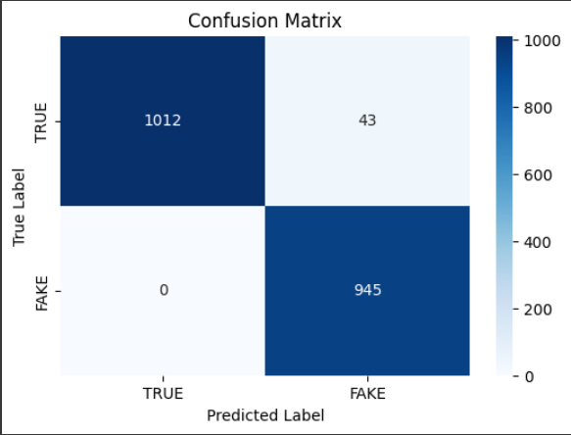
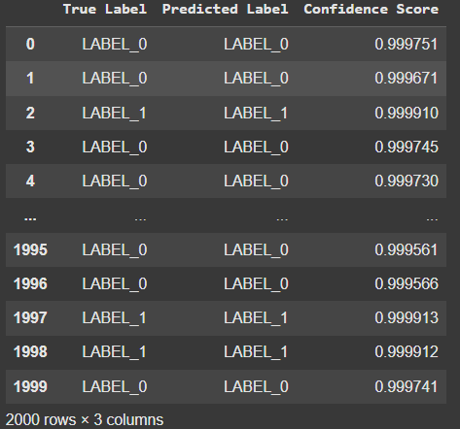
Results from the un-preprocessed text
This setup achieves the highest accuracy with minimal missclassifications.

Slide 15

Conclution
The model perfomes best with un-preprocessed text, suggesting that the text preprocessing may remove critical contextual information.
Concidering accuracy of 86,85 % on titles, fine-tuning the model focused on titles rather than text could be a promising direction.
The model demonstrates strong performance on un-preprocessed text with 97.85 %.

Slide 16
References
OpenAI. (2024). ChatGPT-4. Retrieved from https://openai.com
Google. (2024). Google Gemini AI. Retrieved from https://ai.google
GonzaloA. (n.d.). Fake news dataset [Dataset]. Hugging Face. Retrieved from https://huggingface.co/datasets/GonzaloA/fake_news
jy46604790. (n.d.). Fake-News-Bert-Detect [Model]. Hugging Face. Retrieved from https://huggingface.co/jy46604790/Fake-News-Bert-Detect

